Slide 1
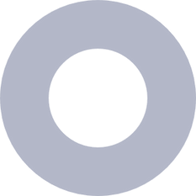


05 Dec, 2024
BMP
PRESENTATION
RemoteSense
Prof. Rutu Parekh
Saumya 202101167
Shlok 202101257

Slide 2

OBJECTIVES

Slide 3
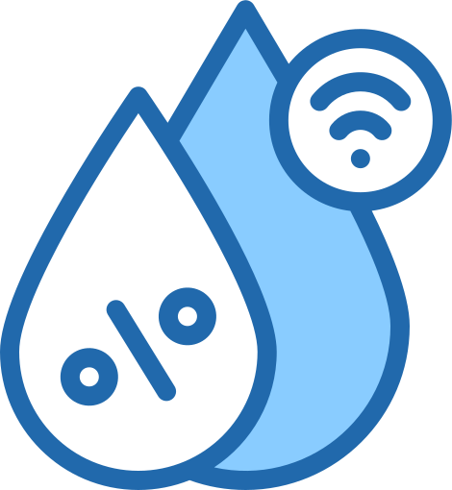

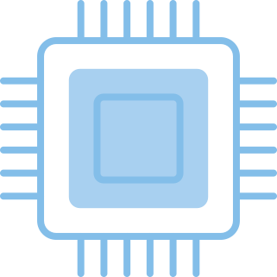
PROJECT OBJECTIVES
Real-Time Data Monitoring and Visualization
Remote Control of Connected Devices
Seamless IoT Integration and Automation
To collect environmental data using Arduino sensors and upload it to cloud platforms like ThingSpeak and Arduino Cloud,
enabling real-time monitoring and graphical visualization of sensor readings on web and mobile applications.
To integrate control mechanisms via the cloud platforms, allowing users to remotely toggle and manage connected devices (e.g., LED, motors, etc.)
using dashboards or mobile applications.
To establish a framework for integrating IoT devices with cloud-based services, paving the way for automation, advanced analytics, and integration
with third-party ecosystems like Alexa for voice-based control and monitoring.

Slide 4

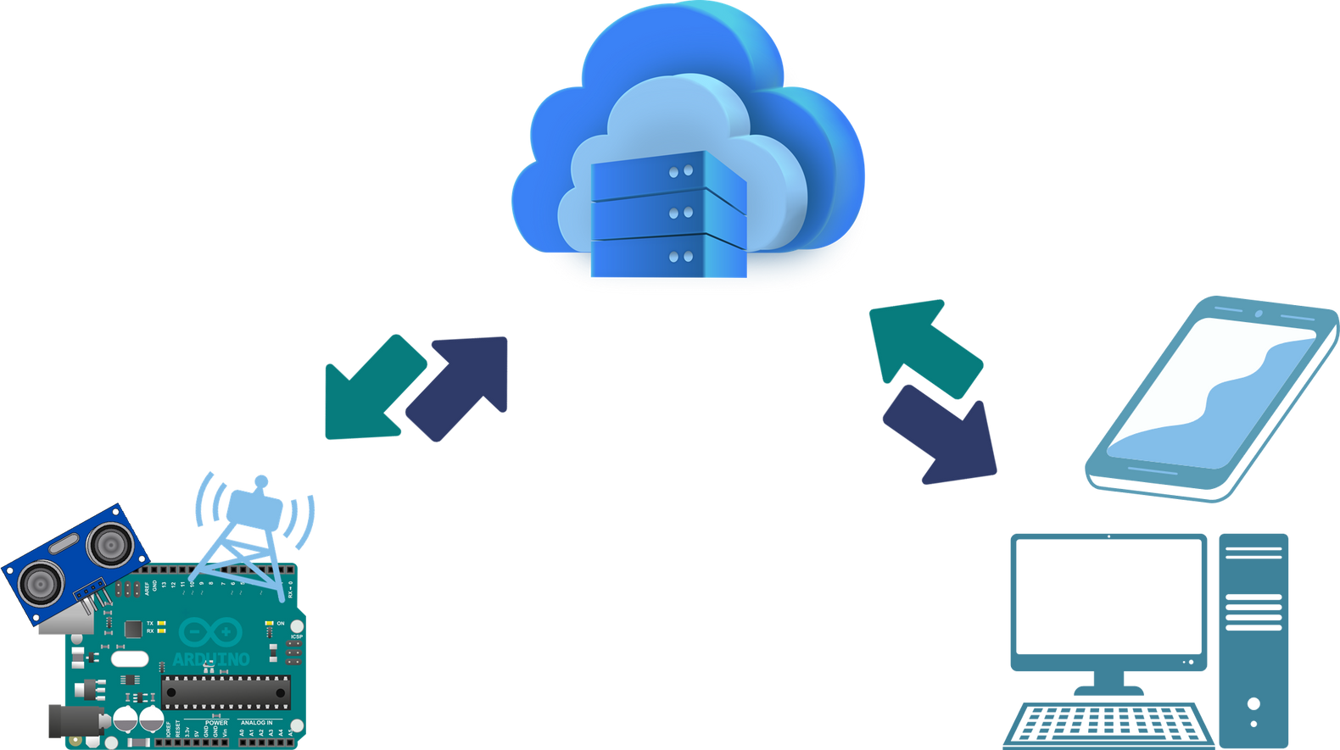
ARCHITECTURE
Cloud
Microcontroller
Users

Slide 5
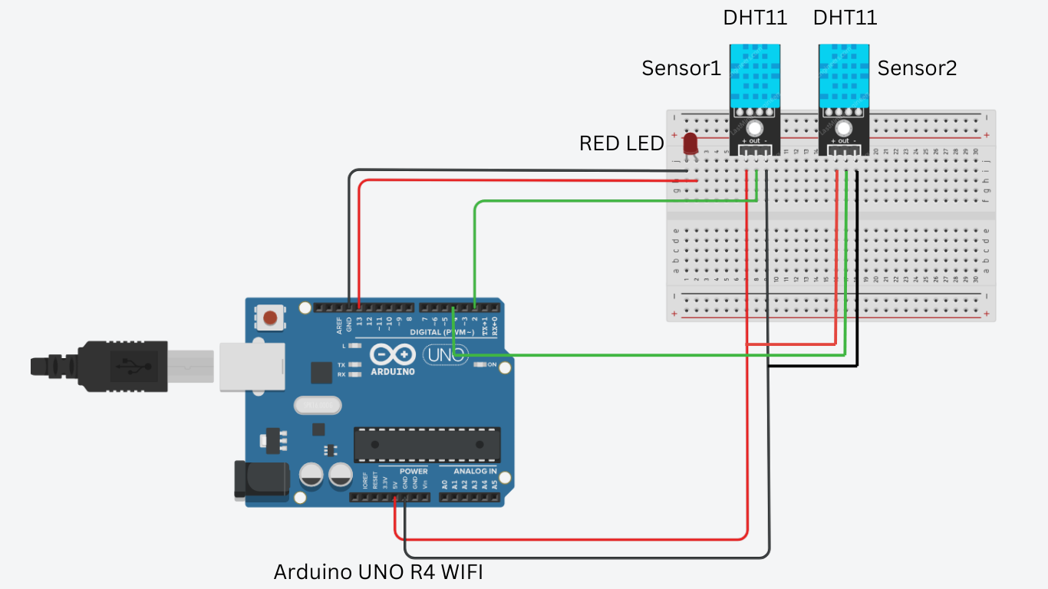
SCHEMATIC

Slide 6




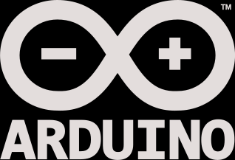
ThingSpeak
Google Firebase
CLOUD SERVICES
ThingSpeak
Arduino Cloud

Slide 7

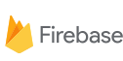
FIREBASE

Slide 8

CHALLENGES
We aimed to use Firebase for storing and managing sensor data due to its real-time database and compatibility with mobile app development.
Limited Resources: The Arduino R4 WiFi has limited memory, and the Firebase libraries were too resource-intensive.
Library Overhead: The Firebase libraries consumed a significant portion of the available memory, leading to performance issues.
Compatibility Concerns: Integration of Firebase with Arduino was less straightforward.

Slide 9
THINGSPEAK

Slide 10

WHAT WE DID?
Hardware Integration:
Used Arduino Uno R4 WiFi with temperature and humidity sensors.
Enabled device control (e.g., LED).
Cloud Platforms:
ThingSpeak Cloud: For data collection, visualization, and control using APIs.
Created 2 channels for sensors and LED.
Web and Mobile Apps:
Website: Displayed detailed analytics and enabled remote control using ThingSpeak APIs.
Android App: Provided real-time data visualization and interaction on mobile devices.

Slide 12
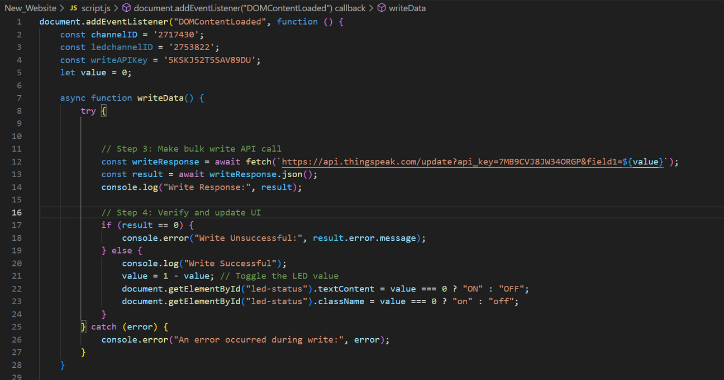
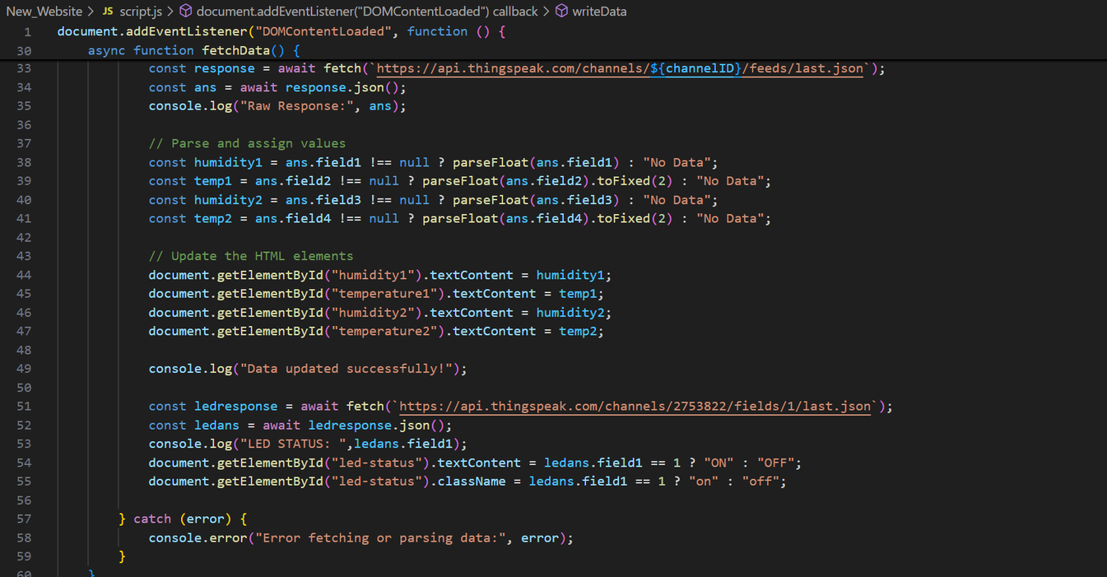
Communication protocol used : REST
APIs provided by thingspeak
</Website>

Slide 13
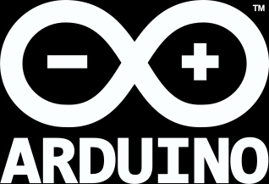
ARDUINO CLOUD

Slide 14
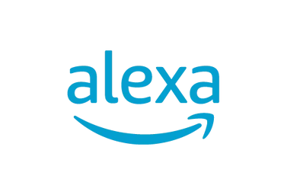

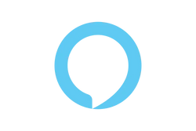
WHAT WE DID?
Sensor Data Upload:
We used Arduino Cloud to collect data from temperature and humidity sensors and upload it to the cloud in real-time.
Dashboard Creation :
Created a user-friendly dashboard to visualize sensor data and monitor changes over time.
Remote Control:
Enabled remote control of devices like LEDs using the Arduino Cloud interface, allowing us to turn sensors on and off remotely.
Alexa Integration:
Integrated Arduino Cloud with Amazon Alexa for voice-based control of the sensors, providing a hands-free experience for users.

Slide 15
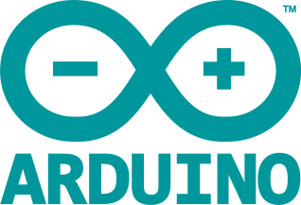
DASHBOARD

Slide 16
Cloud
Platform Analysis
Firebase :
It is intended for managing real-time sensor data and providing cross-platform access but could not be implemented due to heavy library requirements on the Arduino board.
ThingSpeak :
ThingSpeak enabled effective data logging, visualization, and analysis, allowing us to monitor and chart sensor data trends over time.
Arduino Cloud :
It facilitated real-time device control and monitoring via customizable dashboards and provided an accessible interface for interacting with the hardware remotely through web and mobile apps.

Slide 17
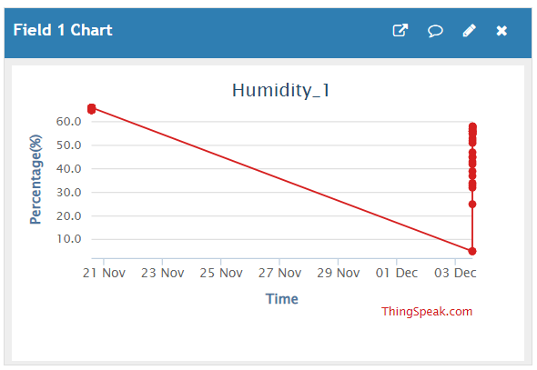
DATA
VISUALIZATION
THINGSPEAK BENIFITS
1. Real-time Data Visualization: ThingSpeak enabled live monitoring of temperature and humidity sensor data on a web dashboard.
2. Cloud Data Storage: It provided a reliable platform to store and manage the sensor data collected from Arduino over time.

Slide 18
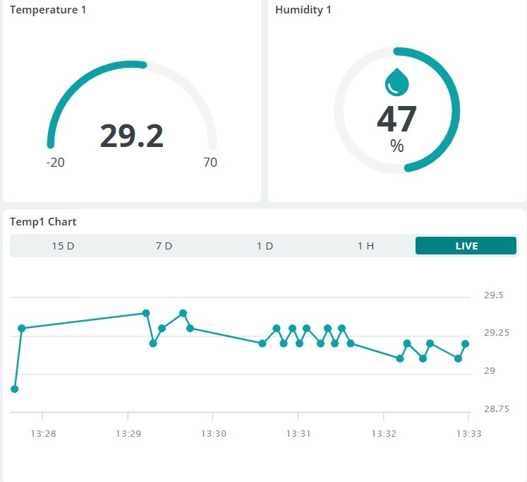
EASY
INTEGRATION
ARDUINO CLOUD
BENIFITS
1. Seamless Integration with Arduino: It provides a direct connection to Arduino boards, making it simple to upload sensor data and control devices.
2. Voice Control via Alexa: Arduino Cloud easily integrates with Alexa, allowing voice-based control of our project.

Slide 19
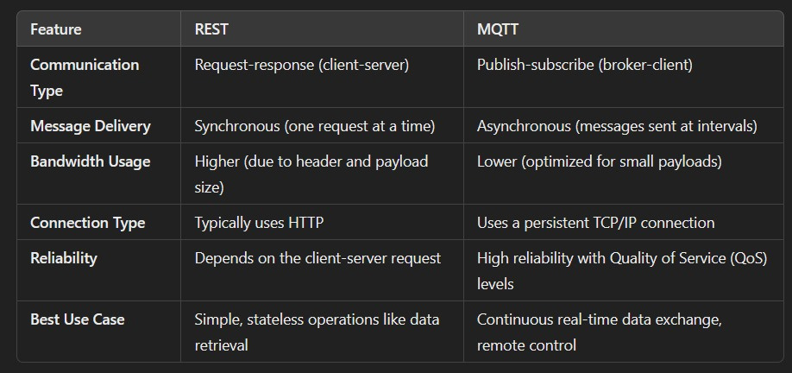
MQTT VS REST

Slide 20
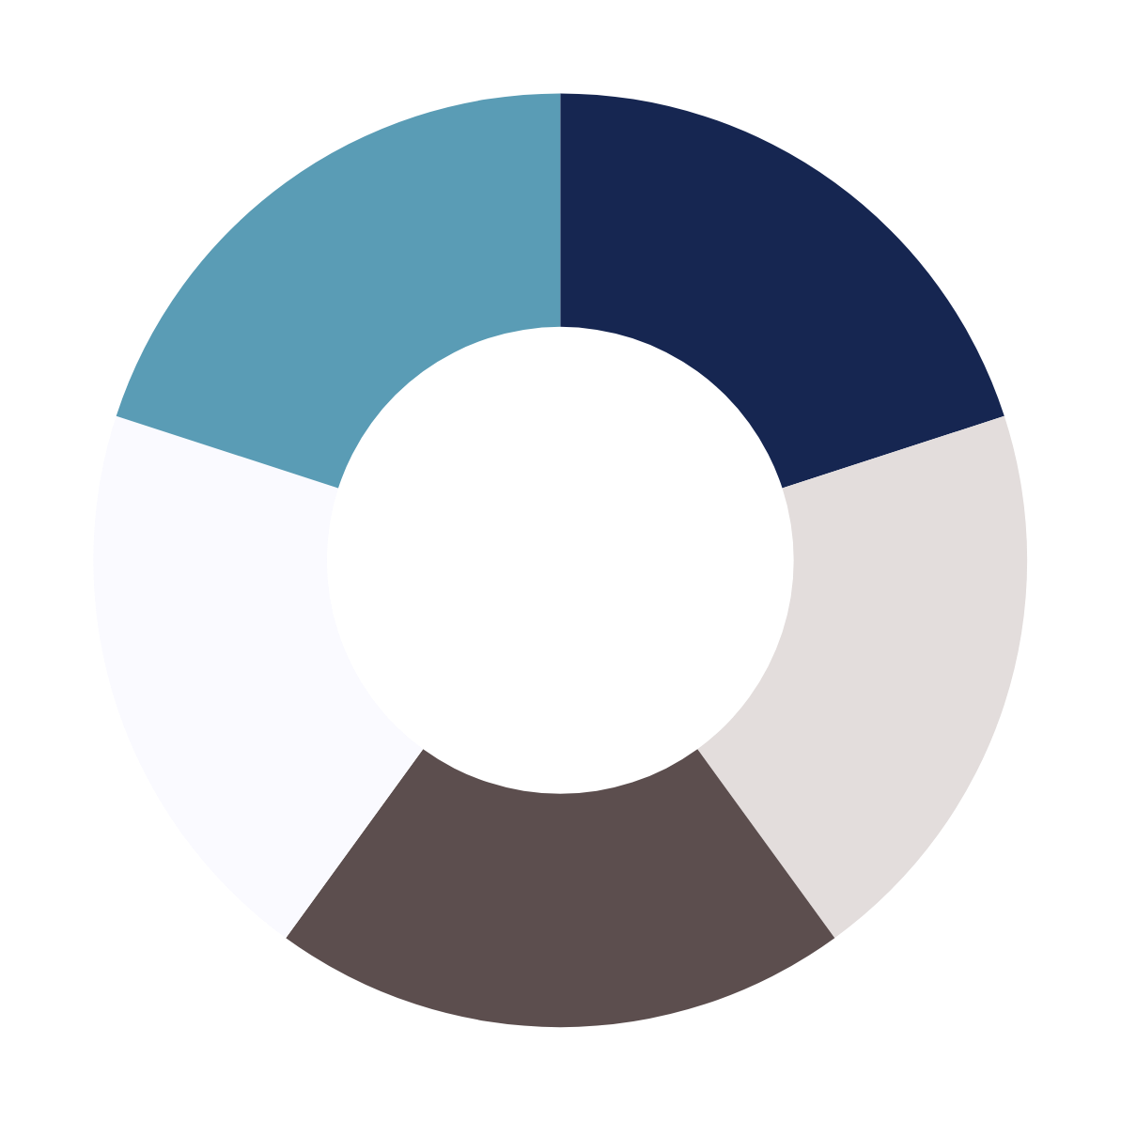
CONCLUSION
ARDUINO CLOUD
It is the best platform for our application as it simplifies the management of Arduino variables and their states, eliminating the complexity for users.
Its user-friendly interface makes it easy for beginners to set up and control devices, making it an ideal choice for smart home applications.

Slide 21
THANK YOU

